Slide 1
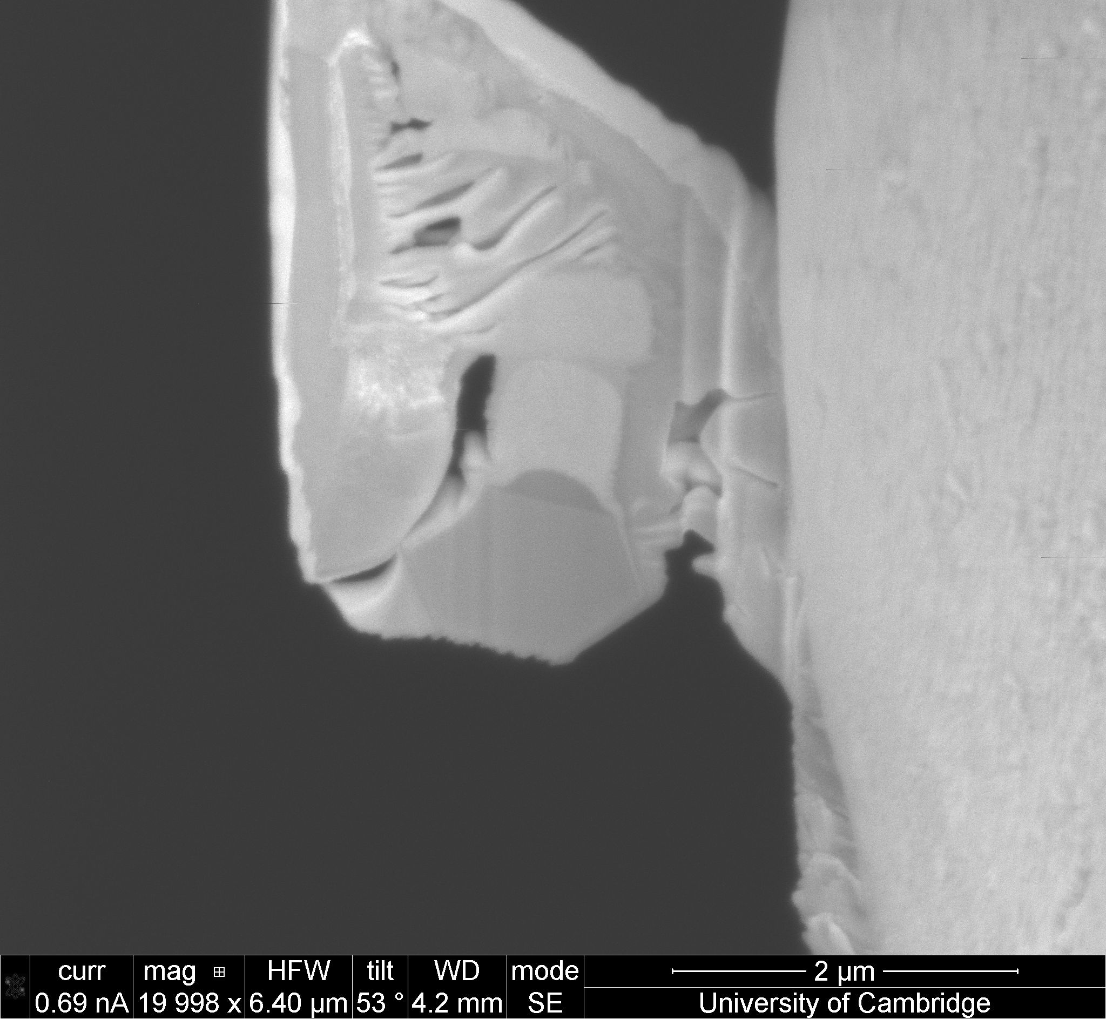
Platinum
TEM grid
Rod

Slide 2
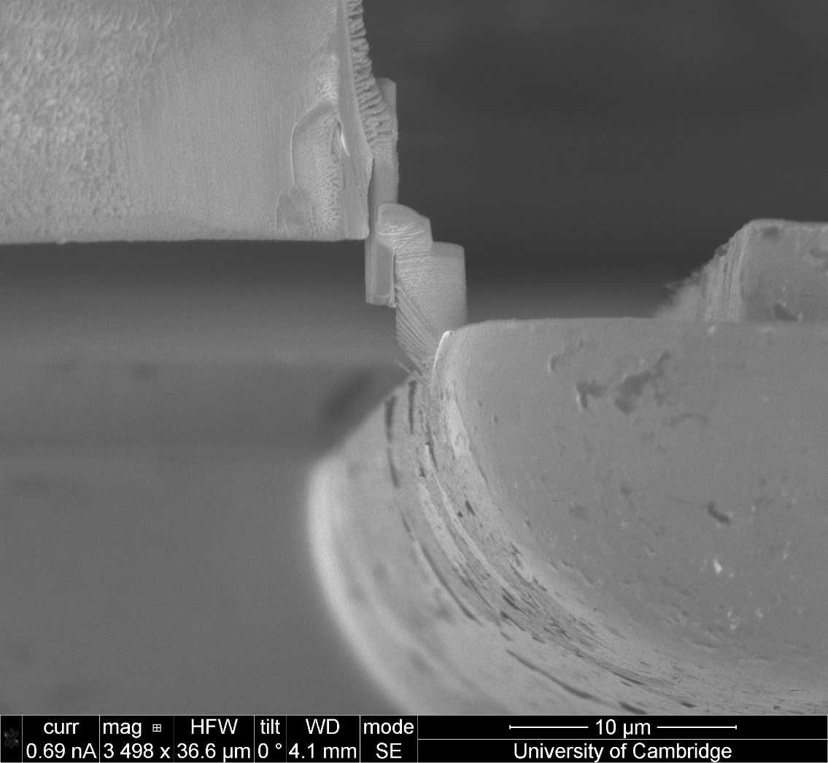
Microrod attached
(Pt)
Microrod
Bottom region

Slide 3
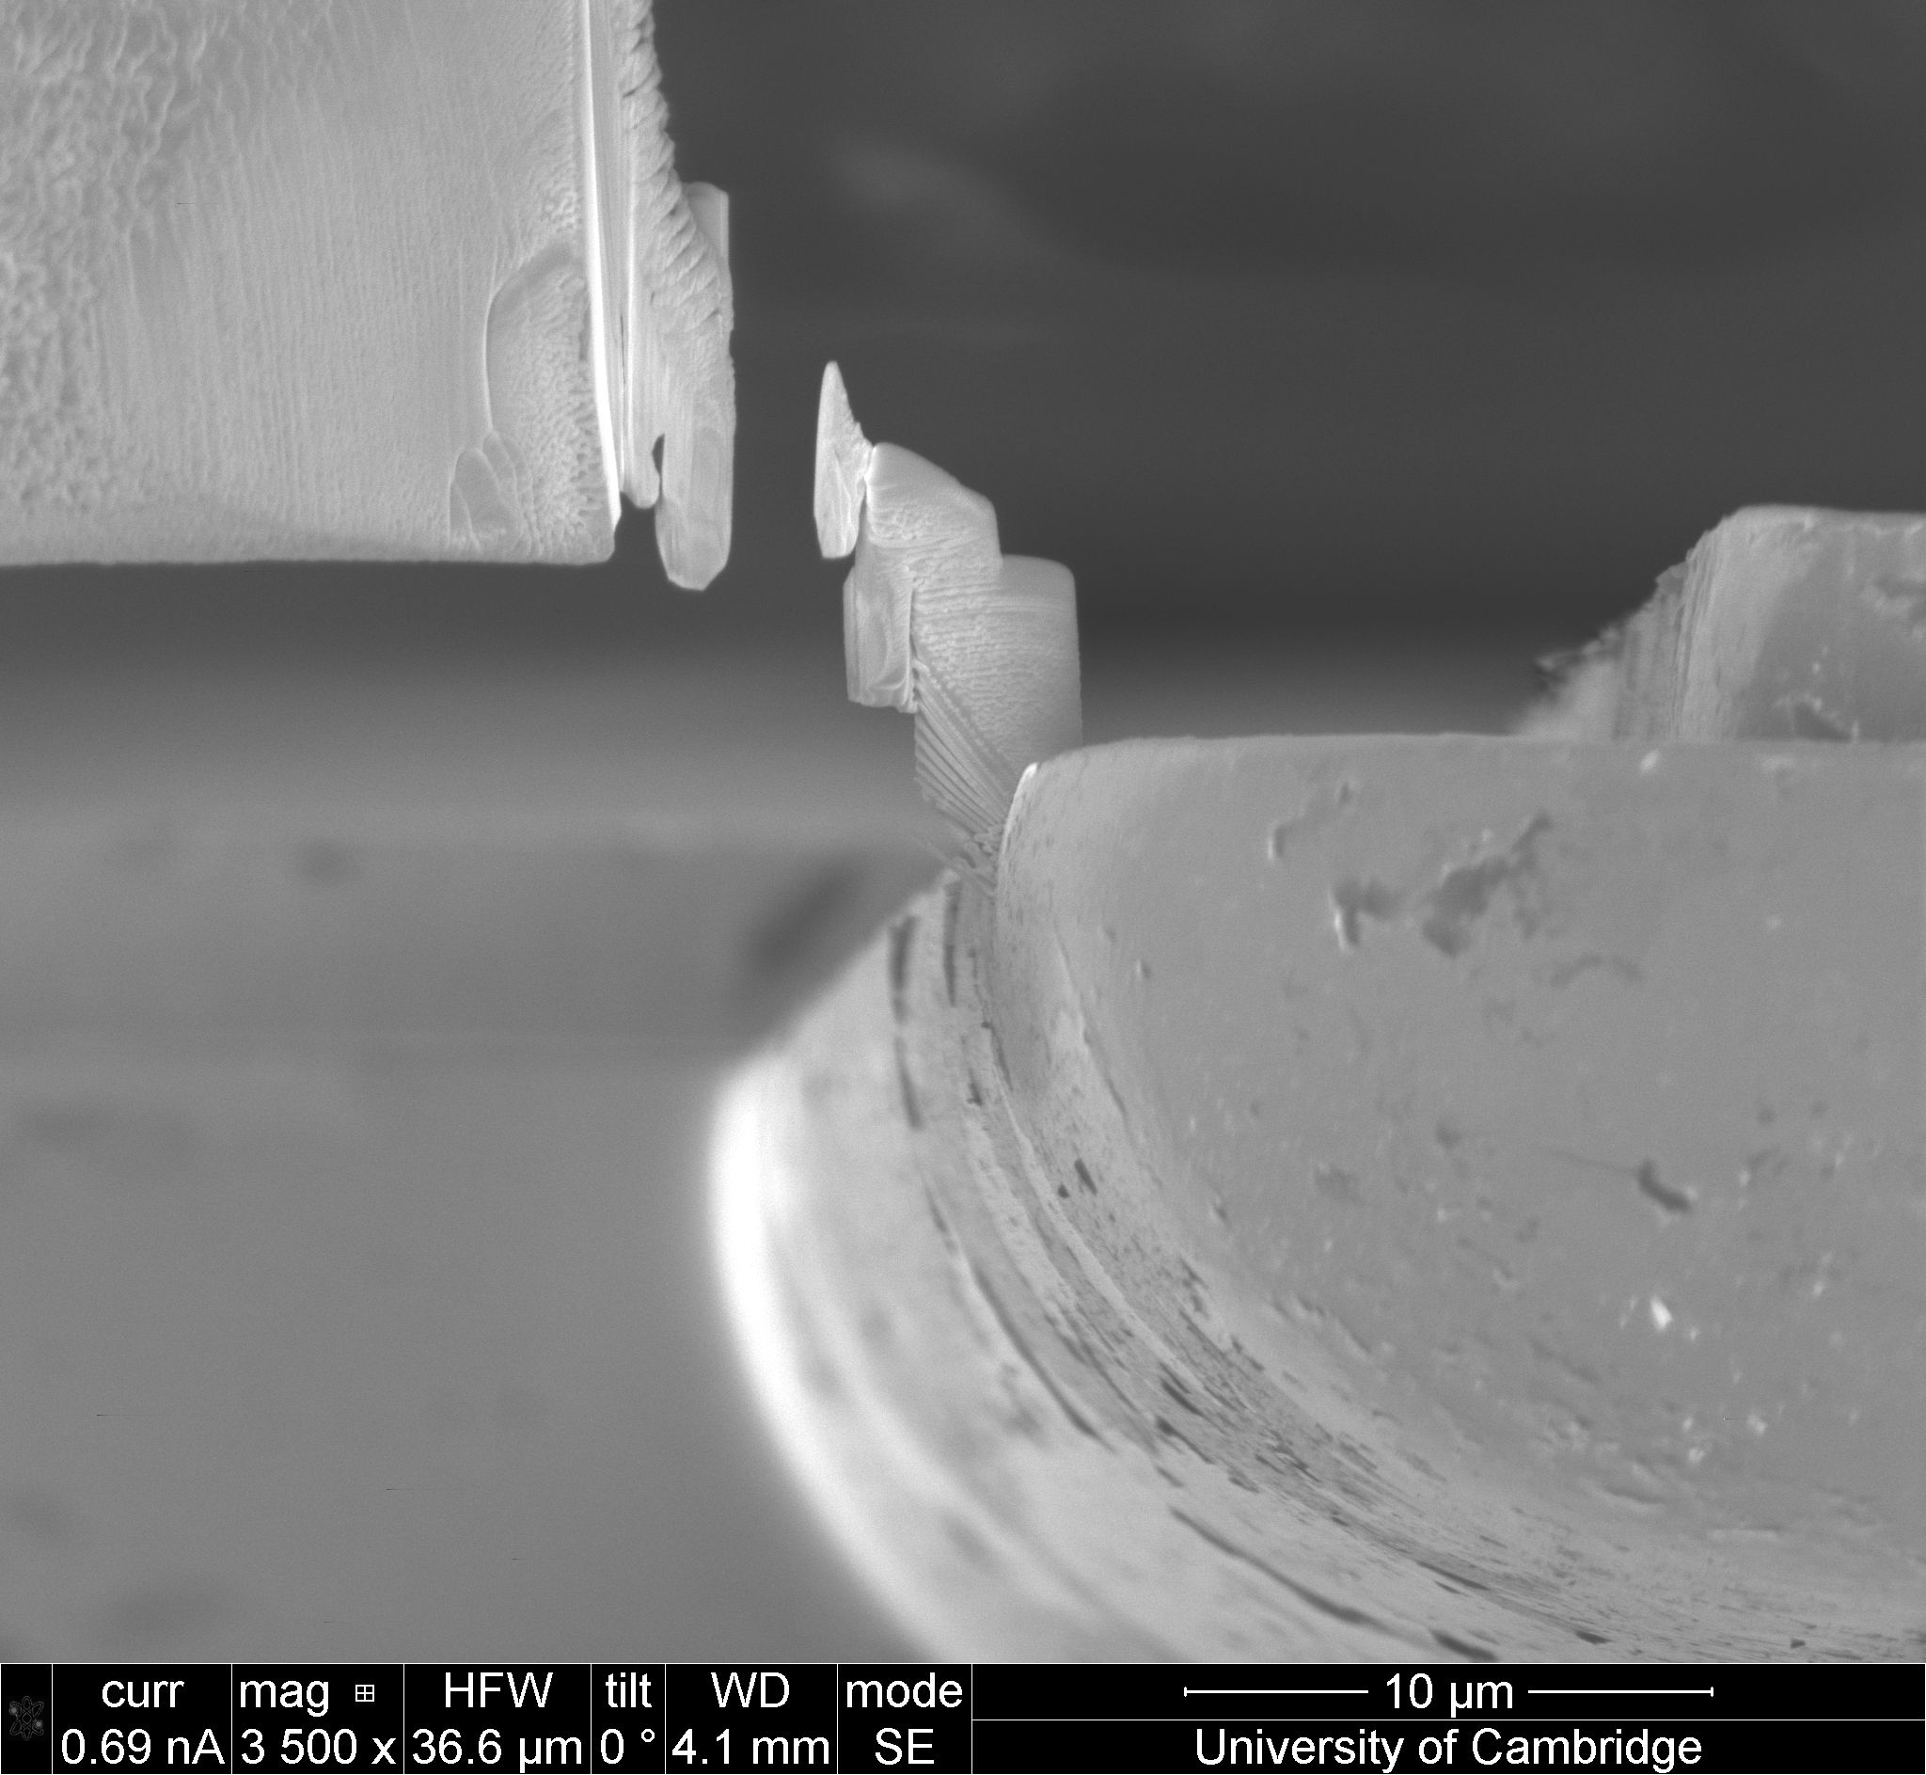
Microrod
top region
(for next sample)
FIB cut
Microrod
Bottom region
(for thinning)

Slide 4
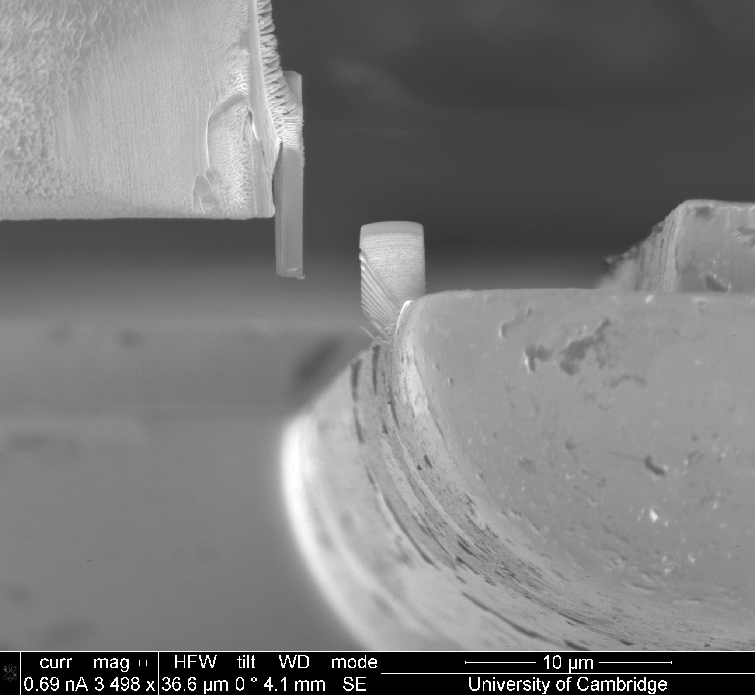
Omniprobe
Platinum
Rod
TEM grid

Slide 5
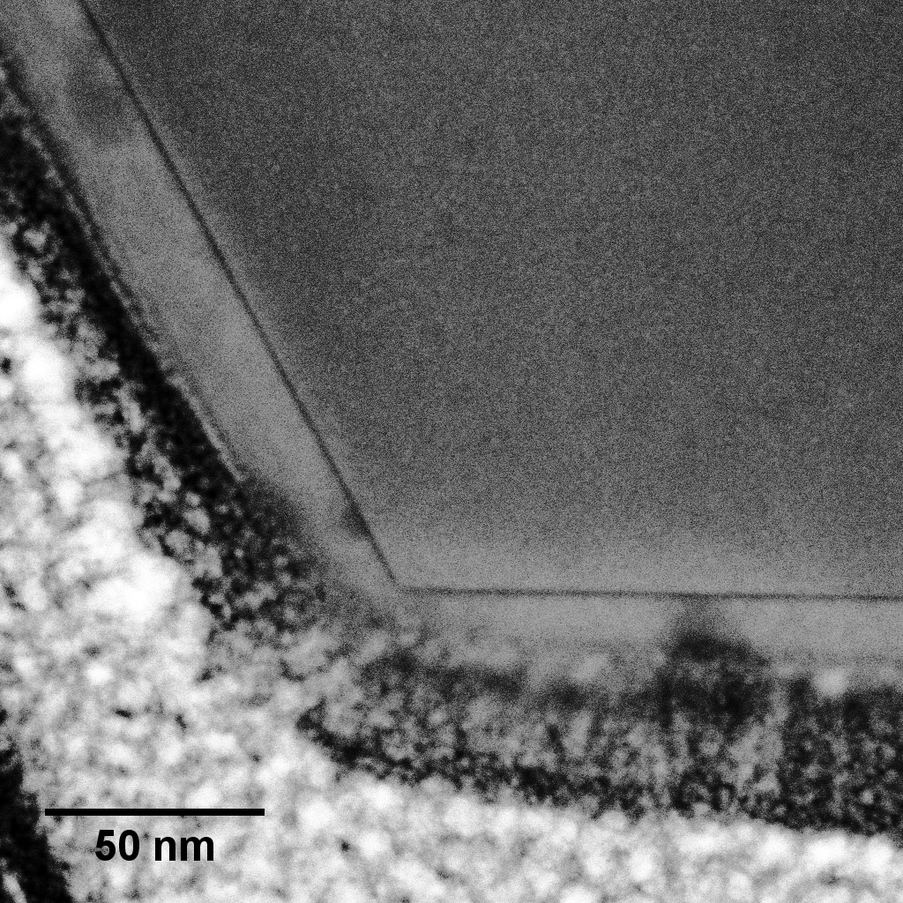
20 nm
Pt

Slide 7
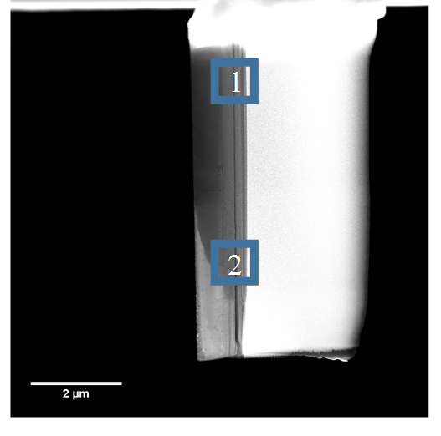
3

Slide 8
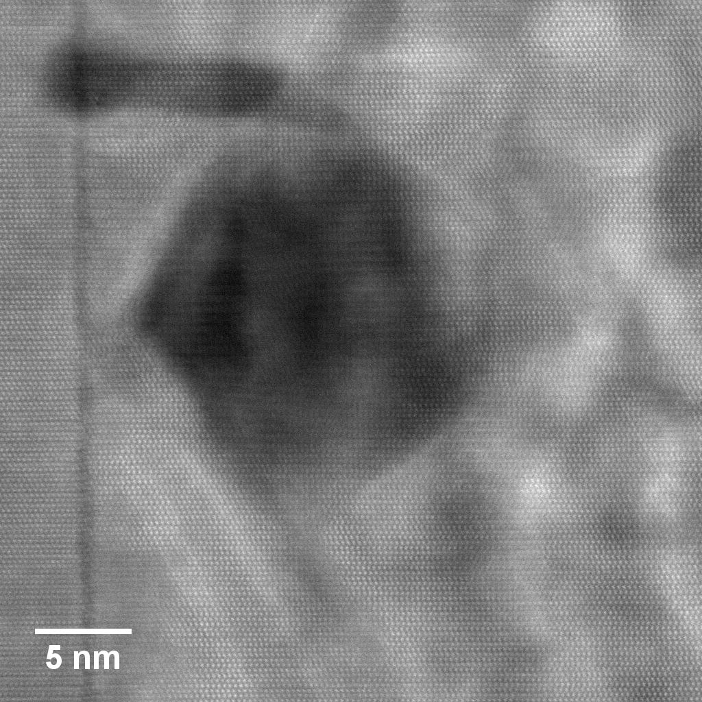

Slide 9
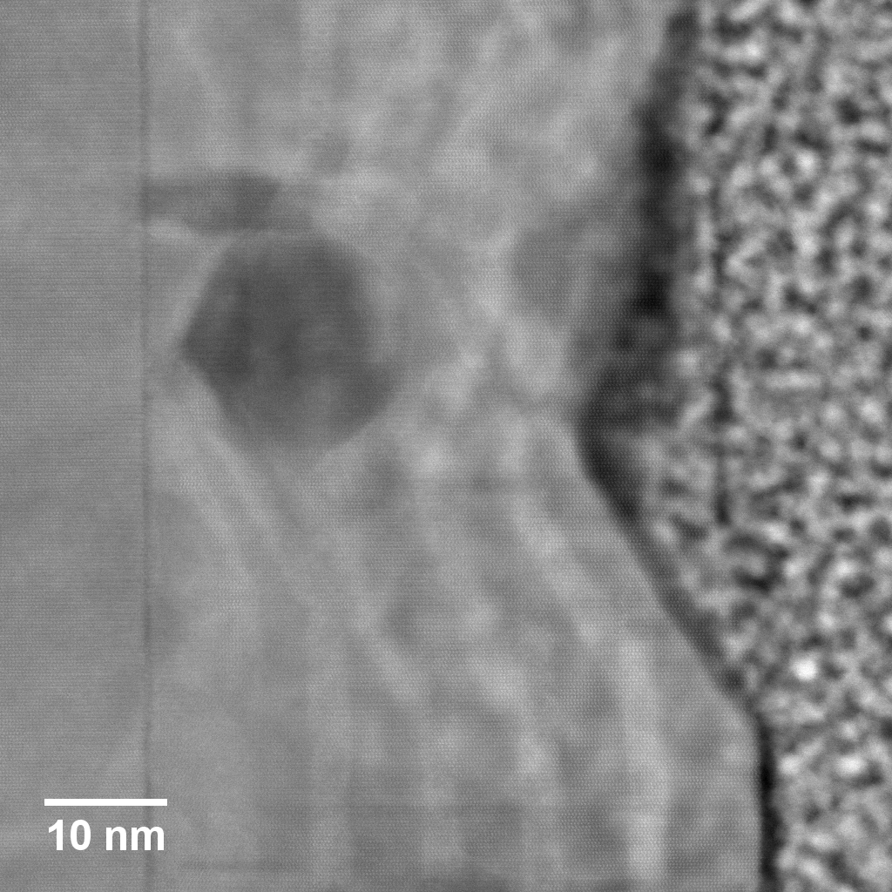

Slide 10
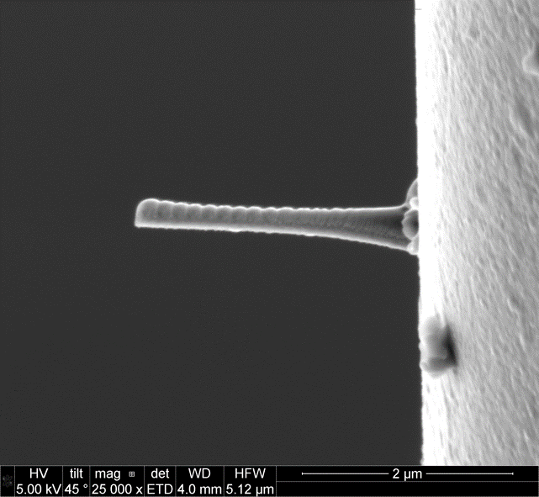
Target Pt Region

Slide 11
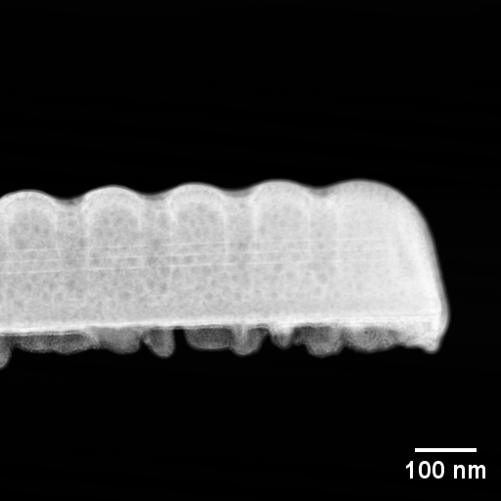
Filled cavity holes
Rounded top
Thin layer of C

Slide 12
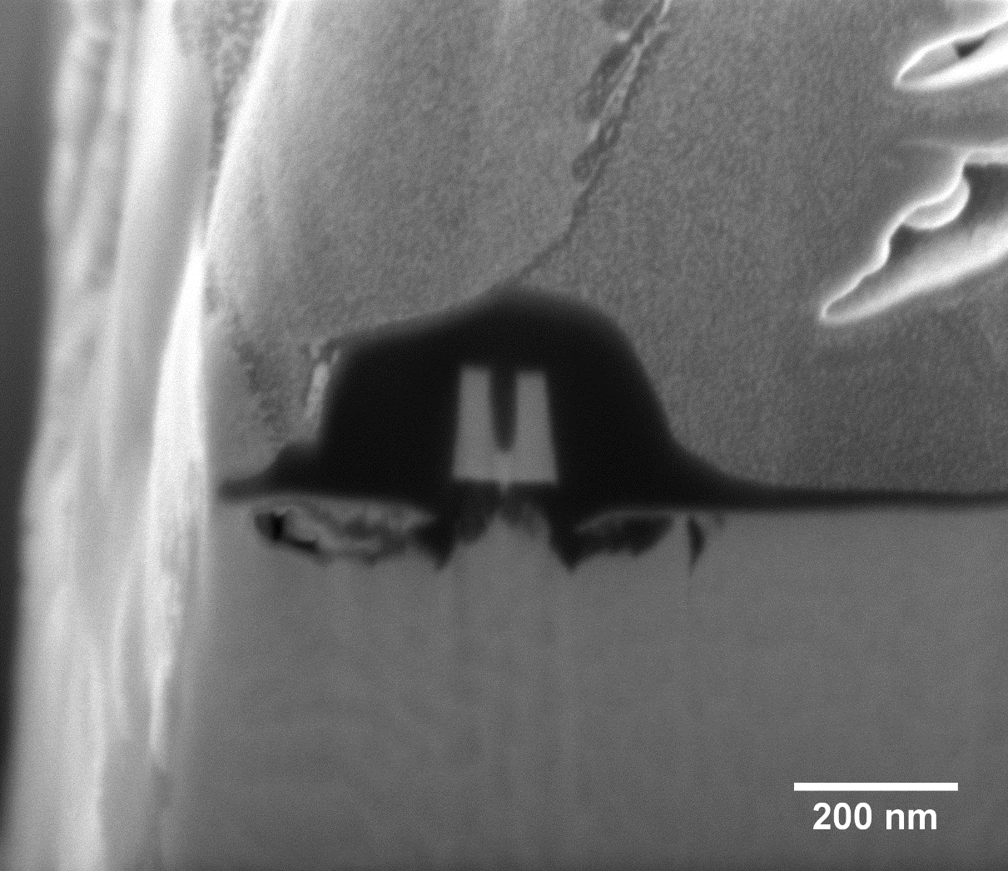
Pt
C
GaN

Slide 13
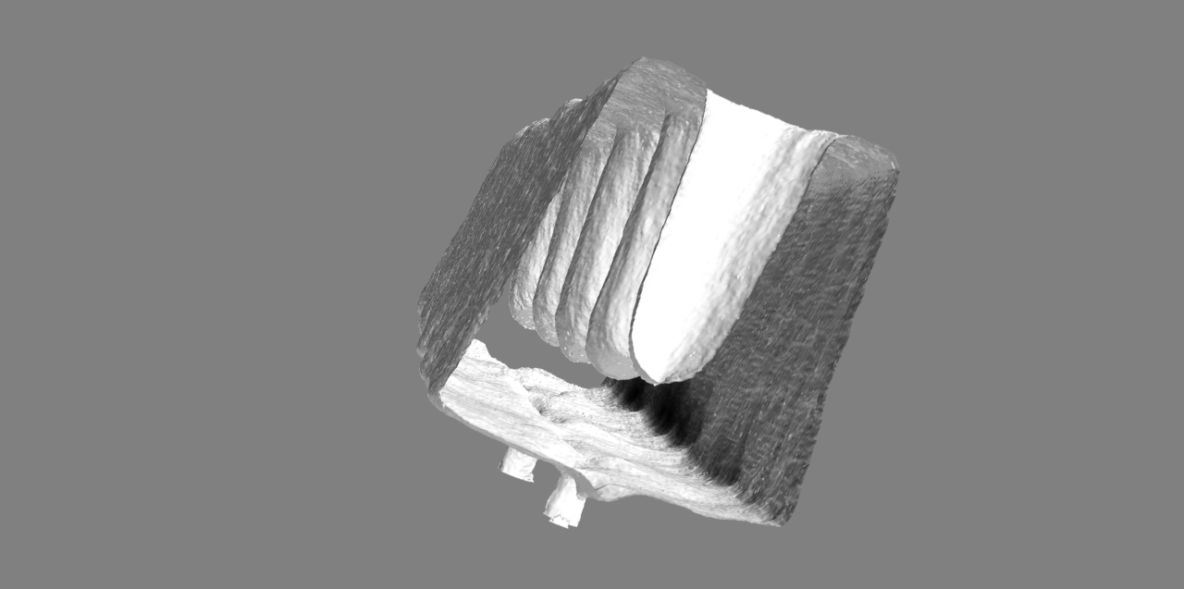
50 nm

Slide 14
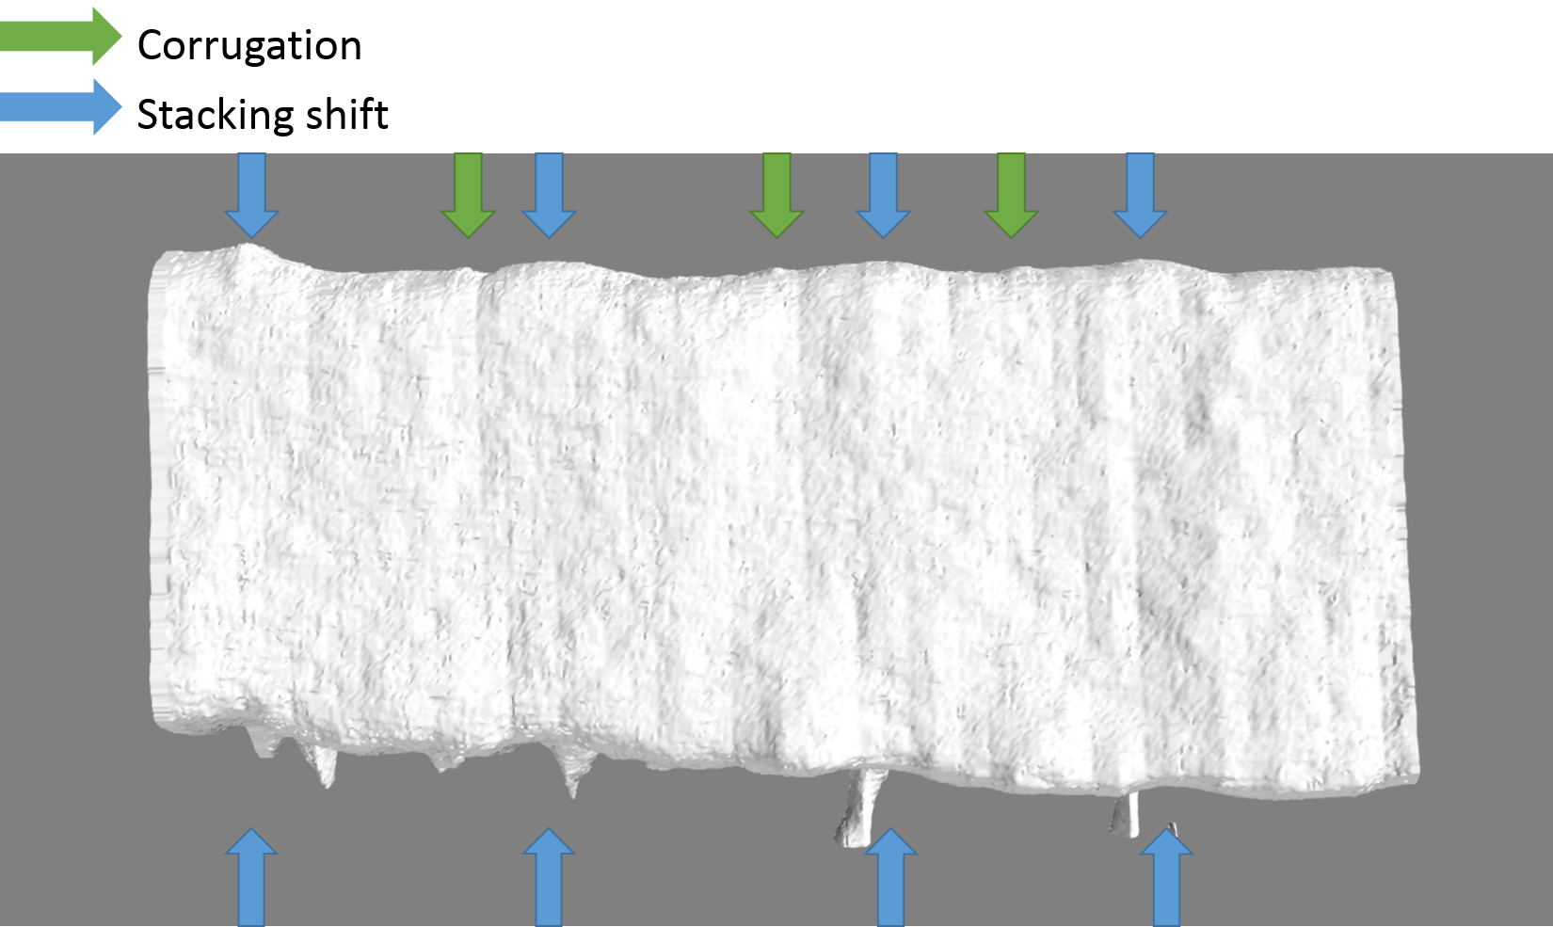
50 nm

Slide 15
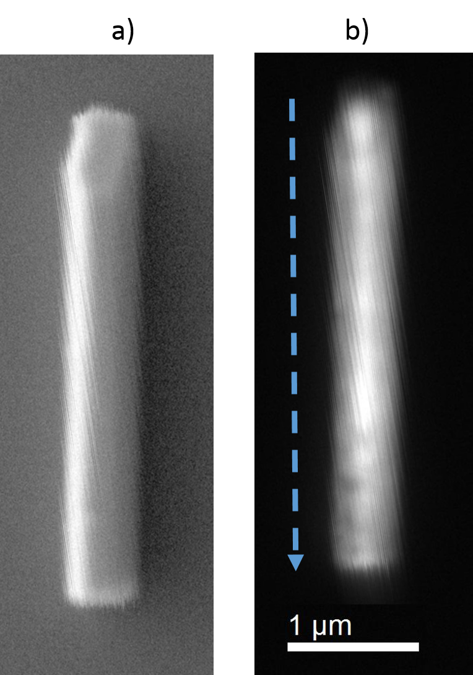
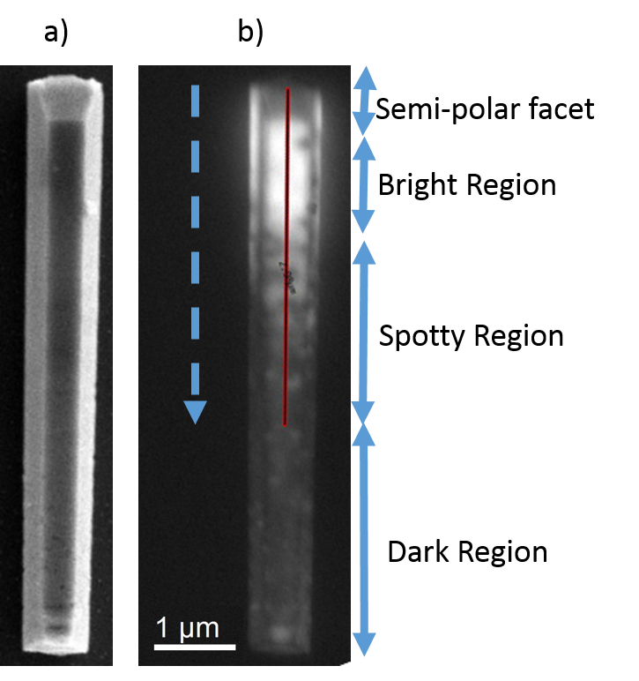
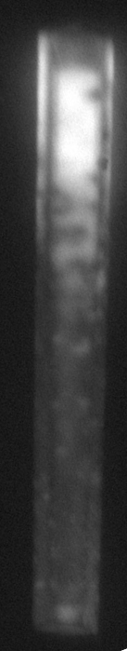

Slide 16
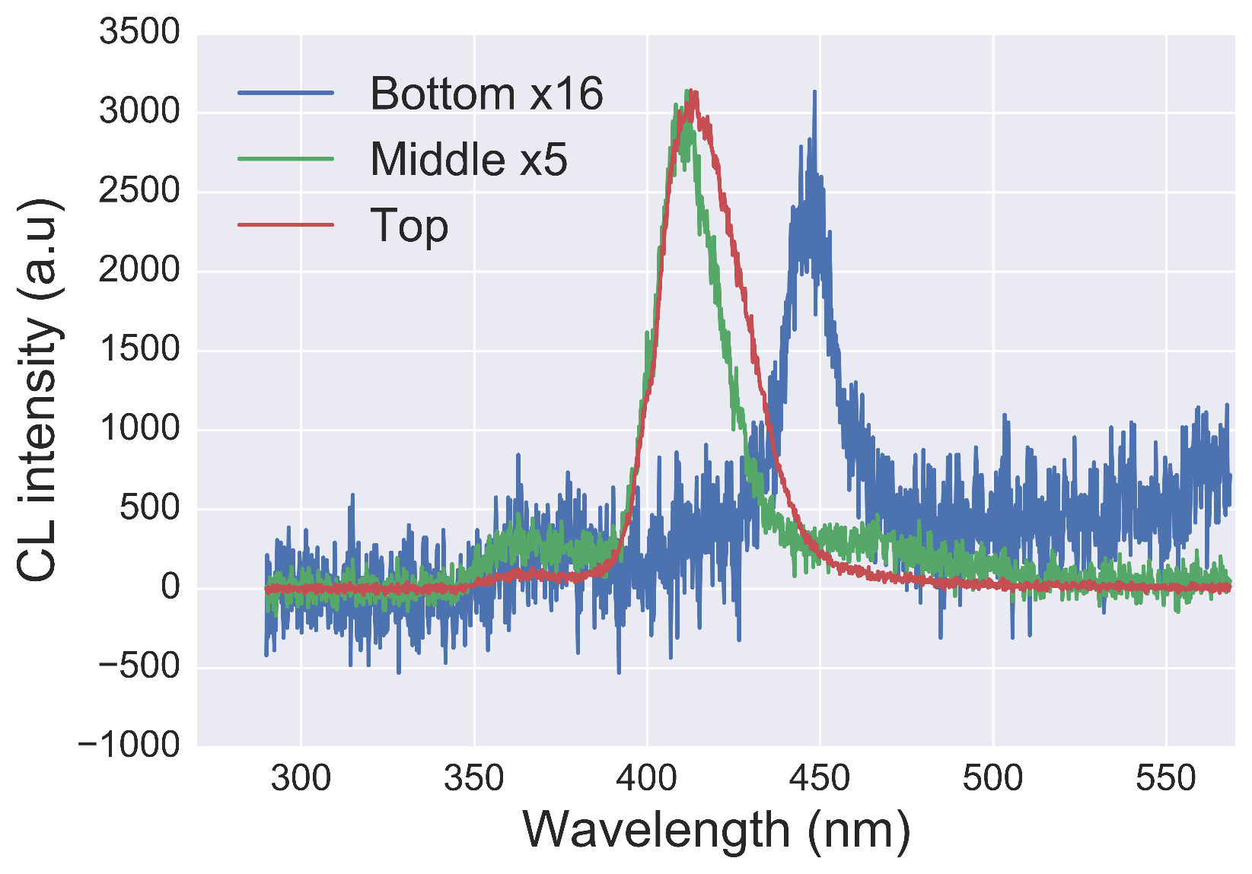

Slide 17
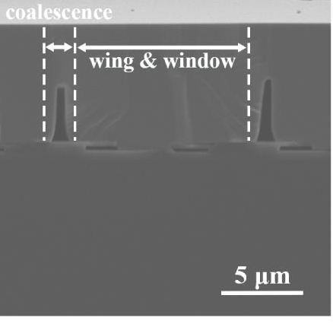
Voids

Slide 18
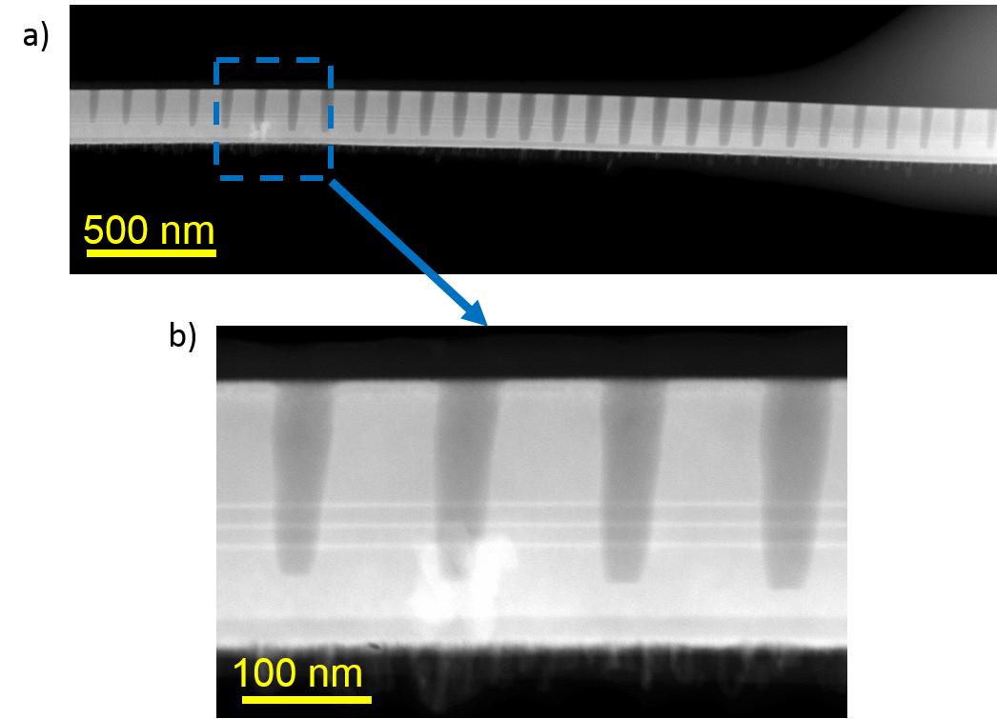
3x InGaN QW
AlGaN

Slide 19

PEC damage

Slide 20
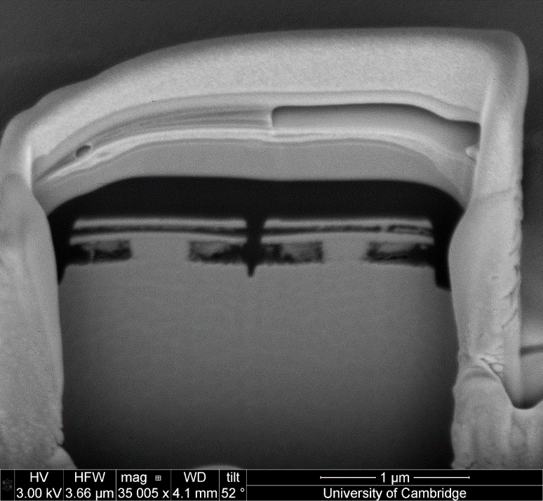
Pt
Carbon
Split microdisk membrane
Unetched material
GaN

Slide 21
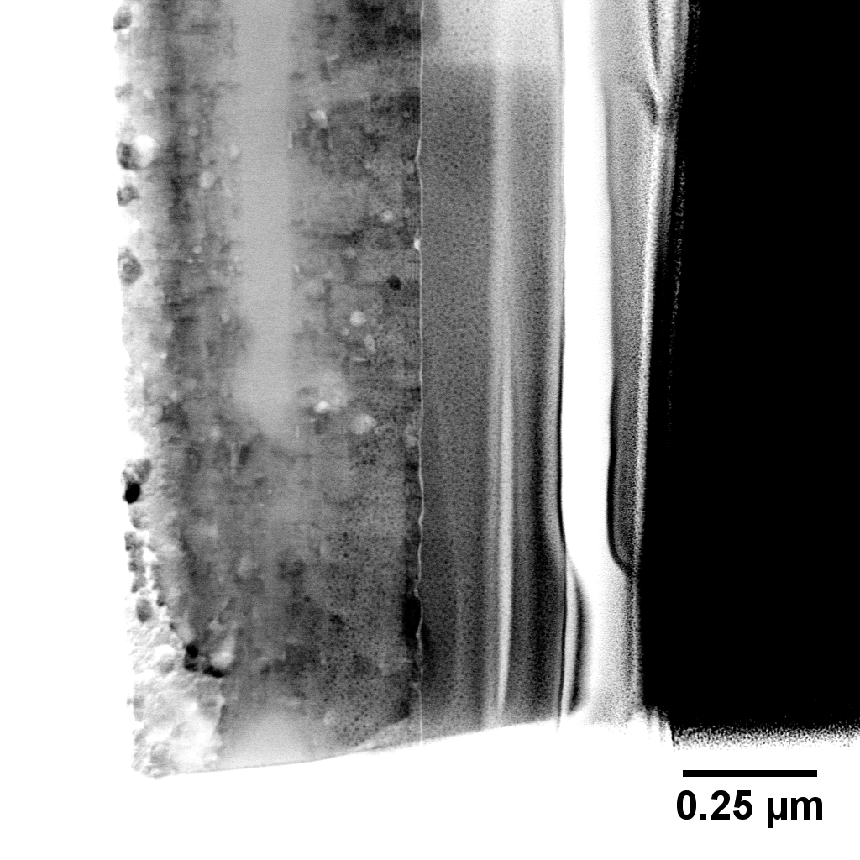
Pt

